Slide 1
Apoptoza u neuromišićnim i neurodegenerativnim bolestima 5. Okrugli stol o apoptozi Akademija Medicinskih Znanosti Hrvatske Zagreb, Hrvatska, 13. III. 2013.
Goran Šimić

Slide 2
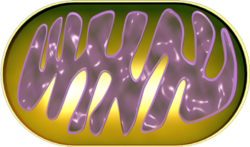
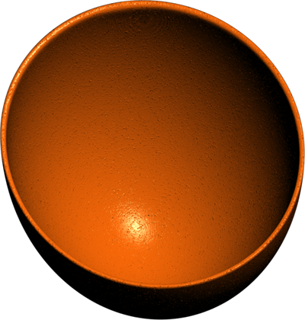
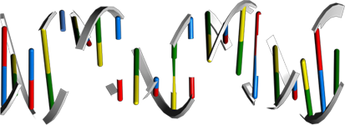
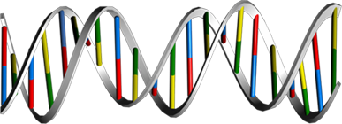
Vanjski put aktivacije apoptoze („Extrinsic" apoptosis pathway)
TNFα
Growth
Factor
Apo2L/
Apo3L
Growth
Factor
TNFR1
Withdrawal
of
Growth
Factors
FasL
Apo2/
Apo3
Fas
Growth
Factor
Receptor
TRADD
TRADD
FADD
RIP
FADD
PKC
FADD
Procaspase 8
TRAF2
Procaspase 8
PI3K
Procaspase 8
p90RSK
BID
Akt1
Caspase 8
FLIP
IκBα
BAD
IKKs
NF-κB
CIAP1
Caspase3
BAX
Caspase 7
SMAC
BAK
VDAC
BCL2
Caspase 9
Arts
tBID
BCLXL
PMR
BIM
Apoptosis
ANT
APAF1
HTRA2
MMP
CypD
Mitochondria
p53AIP1
Cytoc
Noxa
PUMA
Apoptosis
ICAD
Apoptosis
Depolarization
CAD
EndoG
AIF
Oncogenic
Signal
POD
p14(ARF)
PML
PAR4
EndoG
DNA
Fragmentation
AIF
ZIPK
Daxx
FLIP,CIAP2,BFL1,
BCL2
BAK,BAK,BID,
Ras,Noxa,PUMA,
APAF1,Survivin,
BCL2
PARP
CAD
ATM
NF-κB
p53
DNA Fragmentation
Apoptosis
Chk2
p53
MDM2
Notes:
Review:
Apoptosis is a naturally occurring process by which a cell is directed to Programmed Cell Death. Apoptosis is based on a genetic program that is an indispensable part of the development and function of an organism. In this process, cells that are no longer needed or that will be detrimental to an organism or tissue are disposed of in a neat and orderly manner; this prevents the development of an inflammatory response, which is often associated with Necrotic cell death. There are at least two broad pathways that lead to Apoptosis, an "Extrinsic" and an "Intrinsic" Pathway. In both pathways, signaling results in the activation of a family of Cys (Cysteine) Proteases, named Caspases that act in a proteolytic cascade to dismantle and remove the dying cell (Ref.1).
The Extrinsic pathway begins outside a cell, when conditions in the extracellular environment determine that a cell must die. Based on the triggering stimulus and nature of the components involved, at least two Apoptotic pathways can be differentiated; one involving Receptor Systems and the other triggered by Cytotoxic Stress. Receptor mediated pathways include those activated by Death ligands. Death Receptors are Cell surface Receptors that transmit Apoptotic signals initiated by specific ligands and play a central role in instructive Apoptosis. These receptors activate Death Caspases within seconds of ligand binding, causing an Apoptotic demise of the cell within hours. DRs (Death Receptors) belong to the superfamily of TNFR (Tumor Necrosis Factor Receptor), which are characterized by a Cys-rich Extracellular Domain and a homologous Intracellular Domain known as the Death Domain. Adapter-molecules like FADD (Fas-Associated via Death Domain), TRADD (Tumor Necrosis Factor Receptor-1-Associated Death Domain) or Daxx contain Death Domains so that they can interact with the DRs and transmit the Apoptotic signal to the death-machinery. The best-characterized Death Receptors are Fas and TNFR1 (Tumor Necrosis Factor Receptor-1). Other DRs include Apo2 and Apo3 (Ref.2).
FasL (Fas Ligand), a homotrimeric protein acts as ligand for Fas and causes oligomerization of its Receptor on binding. Associated with this is the clustering of the Death Domains and binding of cofactor FADD. The FADD protein binds via its DED (Death Effector Domain) motif to a homologous motif in Procaspase8. The complex of Fas, FADD and ProCaspase8 is called the DISC (Death Inducing Signaling Complex). The cofactor function of FADD, in turn, is blocked by interaction with the regulator FLIP (FLICE Inhibitory Protein). Upon recruitment by FADD, Procaspase8 oligomerization drives its activation through self-cleavage. Active Caspase8 then activates downstream Caspases (Caspase3 and 7), committing the cell to Apoptosis. Activated Caspase8 activates Caspase3 through two pathways. In the first pathway Caspase8 cleaves BID (Bcl2 Interacting Protein) and its COOH-terminal part translocates to Mitochondria where it triggers CytoC (Cytochrome-C) release. The released CytoC binds to APAF1 (Apoptotic Protease Activating Factor-1) together with dATP and Procaspase9 and activates Caspase9. The Caspase9 cleaves Procaspase3 and activates Caspase3. Another pathway is that Caspase8 cleaves Procaspase3 directly and activates it. The Caspase3 cleaves DNA fragmentation factor ICAD (Inhibitor of Caspase-Activated DNase) in a heterodimeric form consisting of CAD and cleaved ICAD. Cleaved ICAD dissociates from CAD, inducing oligomerization of CAD that has DNase activity. The active CAD oligomer causes the internucleosomal DNA fragmentation, which is an Apoptotic hallmark indicative of chromatin condensation (Ref.3). Recently, a nuclear pathway linked to Apoptosis has also been suggested. (ZIPK) ZIP Kinase triggers Apoptosis from nuclear PODs (PML (Promyelocytic Leukemia) Oncogenic Domains) and in collaboration with Daxx and Par-4 (Prostate Apoptosis Response Protein-4), mediates a novel nuclear pathway for Apoptosis. Another set of DRs Apo2 and Apo3 has been characterized that share a different death ligand, known as Apo2L (Apo2 Ligand), Apo3L(Apo3 Ligand). DISC complex formation and BID cleavage downstream of Apo2/Apo3 is similar to the Fas pathway (Ref.4).
In the case of TNFR1, various Death Domain-containing proteins can form distinct complexes in a temporal manner once the receptor is activated. A TNFR1 complex possessing the DD-containing protein TRADD, TRAF2 (TNF Receptor Associated Factor-2), CIAP1 (Cellular Inhibitor of Apoptosis-1), and the kinase RIP1 (Receptor-Interacting Protein-1) assembles at the Plasmamembrane within minutes after activation in order to recruit IKK (I-KappaB-Kinase) leading to NF-KappaB (Nuclear Factor-KappaB) activation and survival. In a second step, Complex II is formed after the TRADD-based complex dissociates from the receptor and recruits FADD and the initiator Caspase8. The balance of effects by complex I versus II rest with FLIP, an inhibitor of Caspase8. When Complex I NF-KappaB activation is sufficient, adequate FLIP is expressed to inhibit Caspase8 of complex II. Complex II can mediate Apoptosis only when Complex I-mediated NF-KappaB activation is insufficient (Ref.5). Besides DRs, Growth factors also influence Apoptosis via PI3K (Phosphatidylinositde-3 Kinase) and Akt (v-Akt Murine Thymoma Viral Oncogene Homolog) pathways. Growth factors binds to growth factor receptors and activates PI3K. Activation of PI3K pathways leads to Akt activation. Akt is very important in BAD (Bcl2-Antagonist of Cell Death) regulation, which is a proapoptotic member of Bcl2 (B-Cell Leukemia-2) family and is involved in Mitochondrial Apoptosis (Ref.6). PKC (Protein Kinase-C) may also play an important role in Apoptosis by activating p90RSKs (Ribosomal-S6 Kinases), which inhibits BAD.
In addition to Receptor-mediated Apoptosis, there is another pathway activated by various forms of Cellular Stress. Stress effects that can induce Apoptosis are Gamma- and UV radiation, treatment with cytotoxic drugs such as Actinomycin D and removal of cytokines. Stress induced Apoptosis occurs by a mechanism that involves altering mitochondrial permeability and subsequent CytoC release and formation of the Apoptosome, a catalytic multiprotein platform that activates Caspase9. Activated Caspase9 then cleaves Caspase3 resulting in downstream events involved in cell death. Release of CytoC is regulated by Bcl2 family proteins. Bcl2L (Bcl2-Like), BclXL (Bcl2 Related Protein Long Isoform) and other Anti-Apoptotic Bcl2 family members reside in the outer mitochondrial membrane and prevent CytoC release. BAX (Bcl2 Associated X-protein), BID (BH3 Interacting Death Domain) and BIM (Bcl2-Interacting Protein) are initially inactive and must translocate to mitochondria to induce Apoptosis, either by forming pores in mitochondria directly or by binding via BH3 domains to Bcl2, BclXL and Bfl1, and antagonizing these Anti-Apoptotic proteins. MMP (Mitochondrial Membrane Permeabilization) is clearly a pivotal event in the progression of Apoptosis in many systems. At least two mechanisms of MMP have been described. First mechanism proposes that VDAC (Voltage-Dependent Anion Channel), ANT (Adenine Nucleotide Transporter), PBR (Peripheral-type Benzodiazepine Receptor) and CypD (Cyclophilin-D) come together to form the PTPC (Permeability Transition Pore Complex). This pore complex may also associate with BAX, BAK1 (Bcl2 Antagonist Killer-1) or BIM, which accelerate channel opening or BclXL, which causes closure. According to the second mechanism BAX is released from its interaction with 14-3-3 and translocates from cytosol to mitochondria in response to diverse signals. Here it oligomerizes forming protein pores. Pore formation also takes place in conjunction with the BH3-only Bcl-2 family member BID upon proteolysis to tBID (Truncated BID). BAK1 is located at mitochondria and has similar pore forming properties to BAX, via its oligomerization and association with tBID. BID is activated by Caspase8-induced cleavage during DR signaling, whereas BIM is released from its association with microtubules (Ref.7).
Apoptosis can also occur via Intrinsic pathways. The Intrinsic Apoptosis pathway begins when an injury occurs within the cell. Intrinsic stresses such as Oncogenes, direct DNA damage, Hypoxia, and survival factor deprivation, can activate the Intrinsic Apoptotic pathway. p53 is a sensor of cellular stress and is a critical activator of the intrinsic pathway. The DNA checkpoints proteins, ATM (Ataxia Telangiectasia Mutated protein), and Chk2 (Checkpoints Factor-2) directly phosphorylate and stabilize p53 and inhibit MDM2 (Mouse Double Minute-2 Homolog) mediated ubiquitination of p53. MDM2 binds p53 and mediates the nuclear export. When bound to MDM2, p53 can no longer function as an activator of transcription. p53 initiates Apoptosis by transcriptionally activating proapoptotic Bcl2 family members and repressing antiapoptotic Bcl2 proteins and CIAPs. Other p53 targets include BAX, Noxa, PUMA (p53-Upregulated Modulator of Apoptosis) and the most recently identified, BID. p53 also transactivates other genes that may contribute to Apoptosis including PTEN (Phosphatase and Tensin Homolog Deleted On Chromosome-10), APAF1, Perp, p53AIP1 (p53-regulated Apoptosis-Inducing Protein-1), and genes that lead to increases in ROS (Reactive Oxygen Species). These ROS lead to generalized oxidative damage to all Mitochondrial components. Damage to Mitochondrial DNA disrupts Mitochondrial oxidative phosphorylation, contributing to a number of Human diseases (Ref.8).
Other proteins released from Damaged Mitochondria, SMAC (Second Mitochondria-Derived Activator of Caspase)/ Diablo, Arts and Omi/HTRA2 (High Temperature Requirement Protein-A2), counteract the effect of IAPs (Inhibitor of Apoptosis Proteins), which normally bind and prevent activation of Caspase3. The interaction between Bcl family members, IAPs, SMAC and Omi/HTRA2 is central to the intrinsic Apoptosis pathway. Recent studies demonstrated that another nuclease, EndoG (Endonuclease-G), is specifically activated by Apoptotic stimuli and is able to induce nucleosomal fragmentation of DNA independently of Caspase and DFF (DNA-Fragmentation Factor)/ CAD (Caspase-Activated DNAse). EndoG is a mitochondrion-specific nuclease that translocates to the nucleus and cleaves chromatin DNA during Apoptosis. Another protein, AIF (Apoptosis Inducing Factor) has also been attributed a role in Apoptosis, becoming active upon translocation from mitochondria to nuclei, where it initiates chromatin condensation and large-scale DNA fragmentation (Ref.9). Programmed cell death and its morphologic manifestation of Apoptosis is a conserved pathway that in its basic tenets appears operative in all metazoans. Apoptosis also operates in adult organisms to maintain normal cellular homeostasis. This is especially critical in long-lived mammals that must integrate multiple physiological as well as pathological death signals, which for example includes regulating the response to infectious agents. Gain and loss of function models of genes in the core Apoptotic pathway indicate that the violation of cellular homeostasis can be a primary pathogenic event that results in disease. Evidence indicates that insufficient Apoptosis can manifest as Cancer or Autoimmunity, while accelerated cell death is evident in Acute and Chronic Degenerative diseases, Immunodeficiency, and Infertility (Ref.10).
References:
1. Czerski L, Nunez G.
Apoptosome formation and Caspase activation: is it different in the heart?
J. Mol. Cell Cardiol. 2004 Sep;37(3):643-52.
PubMed ID: 15350837
2. Jung JY, Kim WJ.
Involvement of mitochondrial- and Fas-mediated dual mechanism in CoCl(2)-induced apoptosis of rat PC12 cells.
Neurosci. Lett. 2004 Nov 23;371(2-3):85-90.
PubMed ID: 15519734
3. Pirnia F, Schneider E, Betticher DC, Borner MM.
Mitomycin C induces apoptosis and caspase-8 and -9 processing through a caspase-3 and Fas-independent pathway.
Cell Death Differ. 2002 Sep;9(9):905-14.
PubMed ID: 12181741
4. Kelley RF, Totpal K, Lindstrom SH, Mathieu M, Billeci K, Deforge L, Pai R, Hymowitz SG, Ashkenazi A.
Receptor-selective mutants of Apo2L/TRAIL reveal a greater contribution of DR5 than DR4 to apoptosis signaling.
J. Biol. Chem. 2004 Nov 1
PubMed ID: 15520016
5. Sutheesophon K, Nishimura N, Kobayashi Y, Furukawa Y, Kawano M, Itoh K, Kano Y, Ishii H, Furukawa Y.
Involvement of the tumor necrosis factor (TNF)/TNF receptor system in leukemic cell apoptosis induced by histone deacetylase inhibitor depsipeptide (FK228).
J. Cell Physiol. 2004 Oct 28
PubMed ID: 15515013
6. Thompson JE, Thompson CB.
Putting the rap on Akt.
J. Clin. Oncol. 2004 Oct 15;22(20):4217-26.
PubMed ID: 15483033
7. Crow MT, Mani K, Nam YJ, Kitsis RN.
The mitochondrial death pathway and cardiac myocyte apoptosis.
Circ. Res. 2004 Nov 12;95(10):957-70.
PubMed ID: 15539639
8. Haupt S, Berger M, Goldberg Z, Haupt Y.
Apoptosis - the p53 network.
J. Cell Sci. 2003 Oct 15;116(Pt 20):4077-85.
PubMed ID: 12972501
9. Uren RT, Dewson G, Bonzon C, Lithgow T, Newmeyer DD, Kluck RM.
Mitochondrial release of pro-apoptotic proteins: electrostatic interactions can hold cytochrome c but not Smac/DIABLO to mitochondrial membranes.
J. Biol. Chem. 2004 Nov 9
PubMed ID: 15537572
10. Grzasko N.
Involvement of apoptosis and proinflammatory cytokines in the pathogenesis of anemia in multiple myeloma.
Postepy Hig. Med. Dosw (Online). 2004 Oct 7;58:364-71.
PubMed ID: 15536394

Slide 3
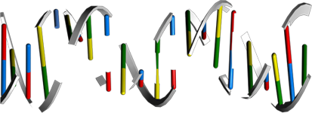
Unutarnji put aktivacije apoptoze („Intrinsic" pathway - /mitochondrial/ apoptosis)
FasL
Growth Factors
Withdrawal of Growth Factors
Chemothera-peutic Drugs
Fas
Growth Factor Receptor
Procaspase 8
FADD
PKC
PI3K
p90RSK
Akt
BAD
BID
Caspase 8
BAK
tBID
BAX
VDAC
BCL2
CIAP1
SMAC
Caspase 3
BCLXL
PMR
BIM
ANT
Arts
CypD
Caspase9
HTRA2
APOPTOSIS
MMP
p53AIP1
APAF1
CytoC
Noxa
PUMA
AIF
Depolarization
Endonuclease G
p14ARF
Caspase12
Oncogenic Signal
DNA Fragmentation
AIF
ER Stress
EndoG
MDM2
p53
Gene Expression
DNA Damage
p53
Chk2
ATM
Notes:
Review:
Apoptosis is a naturally occurring process by which a cell is directed to Programmed Cell Death. Apoptosis is based on a genetic program that is an indispensable part of the development and function of an organism. In this process, cells that are no longer needed or that will be detrimental to an organism or tissue are disposed of in a neat and orderly manner; this prevents the development of an inflammatory response, which is often associated with Necrotic cell death. There are at least two broad pathways that lead to Apoptosis, an "Extrinsic" and an "Intrinsic" Pathway. In both pathways, signaling results in the activation of a family of Cys (Cysteine) Proteases, named Caspases that act in a proteolytic cascade to dismantle and remove the dying cell. The extrinsic pathway begins outside a cell, when conditions in the extracellular environment determine that a cell must die. The intrinsic apoptosis pathway begins when an injury occurs within the cell. The injury could result in necrosis and produce an inflammatory response, but the apoptotic machinery is in place to ensure that the damaged cell is packaged and removed cleanly, in order to prevent inflammation. Apoptosis in Mitochondria is the best known intrinsic apoptosis pathway (Ref.1 & 2).
The Mitochondrial pathway of apoptosis functions in response to various types of intracellular stress including Growth Factor withdrawal, DNA damage, unfolding stresses in the Endoplasmic reticulum and Death Receptor stimulation. Fas (CD95/Apo1), a member of the TNFR family, typify the classical view of DR (Death Receptor) function and play an important role in stimulating Mitochondrial apoptotic pathway. FasL (Fas Ligand), a homotrimeric protein acts as ligand for Fas and causes oligomerization of its Receptor on binding. Associated with this is the clustering of the Death Domains and binding of cofactor FADD (Fas-Associated via Death Domain). The FADD protein binds via its DED (Death Effector Domain) motif to a homologous motif in Procaspase8. The complex of Fas, FADD and ProCaspase8 is called the DISC (Death Inducing Signaling Complex). The cofactor function of FADD, in turn, is blocked by interaction with the regulator FLIP (FLICE Inhibitory Protein). Upon recruitment by FADD, Procaspase8 oligomerization drives its activation through self-cleavage. Active Caspase8 then activates downstream Caspases (Caspase3 and 7). Activated Caspase8 activates Caspase3 through two pathways. In the first pathway Caspase8 cleaves BID (Bcl2 Interacting Protein) and its COOH-terminal part translocates to Mitochondria where it triggers CytoC (Cytochrome-C) release. The released CytoC binds to APAF1 (Apoptotic Protease Activating Factor-1) together with dATP and Procaspase9 and activates Caspase9. The Caspase9 cleaves Procaspase3 and activates Caspase3. Another pathway is that Caspase8 cleaves Procaspase3 directly and activates it. Caspase 3 then commits the cell to Apoptosis. Besides DRs, Growth Factors also influence Mitochondrial Apoptosis via PI3K (Phosphatidylinositde-3 Kinase) and Akt (v-Akt Murine Thymoma Viral Oncogene Homolog) pathways. Growth Factors bind to Growth factor receptors and activate PI3K. Activation of PI3K pathways leads to Akt activation. Akt is very important in BAD (Bcl2-Antagonist of Cell Death) regulation, which is a proapoptotic member of Bcl2 (B-Cell Leukemia-2) family and is involved in Mitochondrial Apoptosis (Ref.6). PKC (Protein Kinase-C) may also play an important role in Apoptosis by activating p90RSKs (Ribosomal-S6 Kinases), which inhibits BAD (Ref. 3, 4 & 5).
In addition to Receptor-mediated Apoptosis, there is another pathway activated by various forms of Cellular Stress. Intrinsic stresses such as Oncogenes, direct DNA damage, Hypoxia, and Survival factor deprivation, can activate the Intrinsic Apoptotic pathway. p53 is a sensor of cellular stress and is a critical activator of the intrinsic pathway. The DNA checkpoints proteins, ATM (Ataxia Telangiectasia Mutated protein), and Chk2 (Checkpoints Factor-2) directly phosphorylate and stabilize p53 and inhibit MDM2 (Mouse Double Minute-2 Homolog) mediated ubiquitination of p53. MDM2 binds p53 and mediates the nuclear export. When bound to MDM2, p53 can no longer function as an activator of transcription. p53 initiates Apoptosis by transcriptionally activating proapoptotic Bcl2 family members and repressing antiapoptotic Bcl2 proteins and CIAPs (Cellular Inhibitor of Apoptosis). Other p53 targets include BAX (BCL2 Associated X-protein), Noxa, PUMA (p53-Upregulated Modulator of Apoptosis) and the most recently identified, BID. p53 also transactivates other genes that may contribute to Apoptosis including PTEN (Phosphatase and Tensin Homolog Deleted On Chromosome-10), APAF1, Perp, p53AIP1 (p53-regulated Apoptosis-Inducing Protein-1), and genes that lead to increases in ROS (Reactive Oxygen Species). These ROS lead to generalized oxidative damage to all Mitochondrial components. Damage to Mitochondrial DNA disrupts Mitochondrial oxidative phosphorylation, contributing to a number of Human diseases (Ref. 5 & 6).
Following the reception of stress signals, proapoptotic Bcl2 family proteins are activated and subsequently interact with and inactivate antiapoptotic Bcl2 proteins. Bcl2 family consists of both anti- and proapoptotic members that possess conserved alpha-helices with sequence conservation clustered in Bcl2 Homlogy domains. Proapoptotic members include "Multidomain" BAX family proteins such as BAX, BAK (Bcl2 Antagonist Killer) etc. that display sequence conservation in BH1-3 region and "BH3-only" proteins such as BID, BAD, Noxa, PUMA and BIM (BCL2-Interacting Protein) that have only the short BH3 motif. BAX family proteins act downstream in Mitochondrial disruption, whereas BH3-only proteins act upstream in the pathway, detecting developmental death cures or intracellular damages. Anti-apoptotic members like Bcl2, BclXL and their relatives exhibit homology in all segments BH1-4. The antiapoptotic and proapoptotic protein interaction leads to the destabilization of the Mitochondrial membrane and release of apoptotic factors including CytoC, SMAC (Second Mitochondria-Derived Activator of Caspase), Arts and Omi/HTRA2 (High Temperature Requirement Protein-A2). Bcl2L (Bcl2-Like), BCLXL and other anti-apoptotic BCL2 family members reside in the outer Mitochondrial membrane and prevent CytoC release. BAX , BID and BIM are initially inactive and must translocate to Mitochondria to induce apoptosis, either by forming pores in Mitochondria directly or by binding via BH3 domains to BCL2, BCLXL and BFL1, and antagonizing these anti-apoptotic proteins. MMP (Mitochondrial Membrane Permeabilization) is clearly a pivotal event in the progression of Apoptosis in many systems. At least two mechanisms of MMP have been described. First mechanism proposes that VDAC (Voltage-Dependent Anion Channel), ANT (Adenine Nucleotide Transporter), PBR (Peripheral-type Benzodiazepine Receptor) and CypD (Cyclophilin-D) come together to form the PTPC (Permeability Transition Pore Complex). This pore complex may also associate with BAX, BAK1 or BIM, which accelerate channel opening or BclXL, which causes closure. According to the second mechanism BAX is released from its interaction with 14-3-3 and translocates from cytosol to Mitochondria in response to diverse signals. Here it oligomerizes forming protein pores. Pore formation also takes place in conjunction with the BH3-only Bcl-2 family member BID upon proteolysis to tBID (Truncated BID). BAK1 is located at Mitochondria and has similar pore forming properties to BAX, via its oligomerization and association with tBID. BID is activated by Caspase8-induced cleavage during DR signaling, whereas BIM is released from its association with microtubules (Ref. 5 & 7).
Other proteins released from Damaged Mitochondria, SMAC (Second Mitochondria-Derived Activator of Caspase)/ Diablo, Arts and Omi/HTRA2 (High Temperature Requirement Protein-A2), counteract the effect of IAPs (Inhibitor of Apoptosis Proteins), which normally bind and prevent activation of Caspase3. The interaction between Bcl family members, IAPs, SMAC and Omi/HTRA2 is central to the intrinsic Apoptosis pathway. Recent studies demonstrated that another nuclease, EndoG (Endonuclease-G), is specifically activated by Apoptotic stimuli and is able to induce nucleosomal fragmentation of DNA independently of Caspase and DFF (DNA-Fragmentation Factor)/ CAD (Caspase-Activated DNAse). EndoG is a mitochondrion-specific nuclease that translocates to the nucleus and cleaves chromatin DNA during Apoptosis. Another protein, AIF (Apoptosis Inducing Factor) has also been attributed a role in Apoptosis, becoming active upon translocation from Mitochondria to nuclei, where it initiates chromatin condensation and large-scale DNA fragmentation (Ref.9). Endoplasmic reticulum stress also takes part in apoptosis by activating Caspase3 via Caspase12. Programmed cell death and its morphologic manifestation of Apoptosis is a conserved pathway that in its basic tenets appears operative in all metazoans. Apoptosis also operates in adult organisms to maintain normal cellular homeostasis. This is especially critical in long-lived mammals that must integrate multiple physiological as well as pathological death signals, which for example includes regulating the response to infectious agents. Gain and loss of function models of genes in the core Apoptotic pathway indicate that the violation of cellular homeostasis can be a primary pathogenic event that results in disease. Evidence indicates that insufficient Apoptosis can manifest as Cancer or Autoimmunity, while accelerated cell death is evident in Acute and Chronic Degenerative diseases, Immunodeficiency, and Infertility (Ref. 8 & 9).
References:
1. Wilk S.
Teaching resources. Apoptosis.
Sci. STKE. 2005 May 24;2005(285):tr16.
PubMed ID: 15914728
2. Czerski L, Nunez G.
Apoptosome formation and caspase activation: is it different in the heart?
J. Mol. Cell Cardiol. 2004 Sep;37(3):643-52.
PubMed ID: 15350837
3. Kim R, Emi M, Tanabe K
Role of mitochondria as the gardens of cell death.
Cancer Chemother. Pharmacol. 2005 Sep 21;:1-9
PubMed ID: 16175394
4. Beisner DR, Ch'en IL, Kolla RV, Hoffmann A, Hedrick SM.
Cutting edge: innate immunity conferred by B cells is regulated by caspase-8.
J. Immunol. 2005 Sep 15;175(6):3469-73.
PubMed ID: 16148088
5. Alladina SJ, Song JH, Davidge ST, Hao C, Easton AS.
TRAIL-induced apoptosis in human vascular endothelium is regulated by phosphatidylinositol 3-kinase/Akt through the short form of cellular FLIP and Bcl-2.
J. Vasc. Res. 2005 Jul-Aug;42(4):337-47.
PubMed ID: 15985761
6. Harris SL, Levine AJ.
The p53 pathway: positive and negative feedback loops.
Oncogene. 2005 Apr 18;24(17):2899-908.
PubMed ID: 15838523
7. Kim R.
Unknotting the roles of Bcl-2 and Bcl-xL in cell death.
Biochem. Biophys. Res. Commun. 2005 Jul 29;333(2):336-43.
PubMed ID: 15922292
8. Groenendyk J, Michalak M.
Endoplasmic reticulum quality control and apoptosis.
Acta. Biochim. Pol. 2005;52(2):381-95.
PubMed ID: 15933766
9. Rosenberg P.
Mitochondrial dysfunction and heart disease.
Mitochondrion. 2004 Sep;4(5-6):621-8.
PubMed ID: 16120419

Slide 4
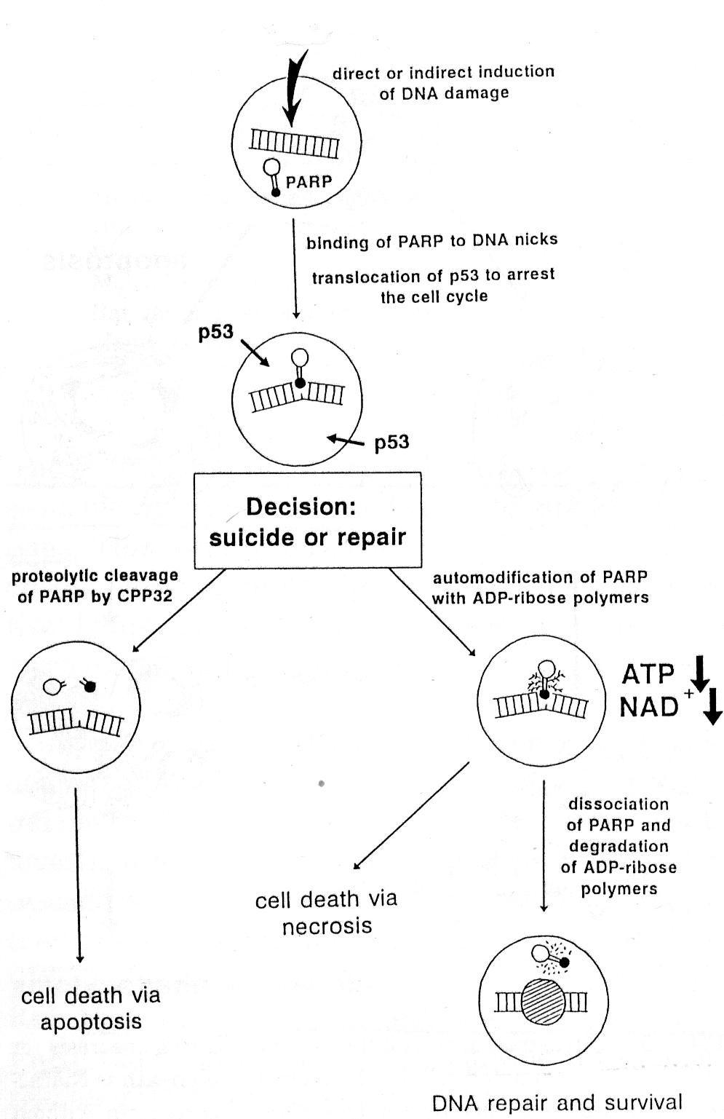
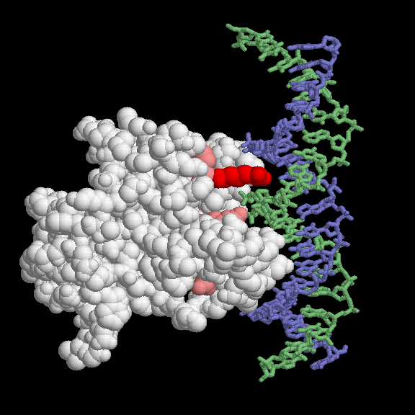
p53

Slide 5
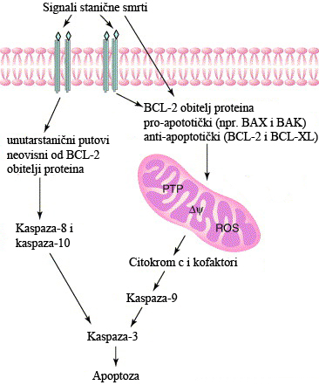
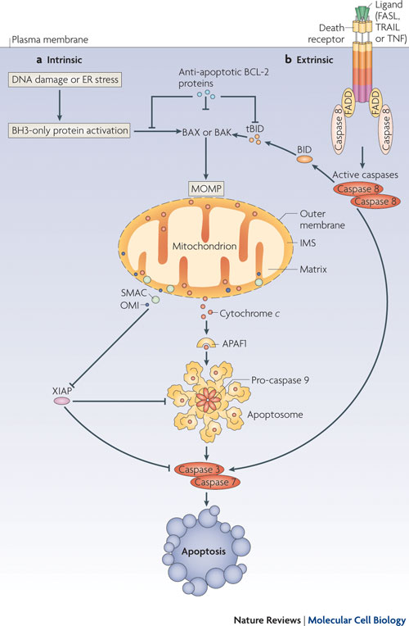
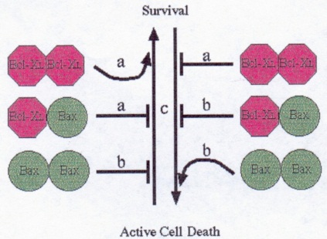
Pojednostavljeni prikaz vanjskog i unutarnjeg puta aktivacije apoptoze
PTP = promjene u permeabilnosti membrane mitohondrija (permeability transition pore),
ΔΨ = membranski potencijal mitohondrija,
ROS = slobodni radikali kisika (reactive oxygen species)
Miller JB, Girgenrath M. The role of apoptosis in neuromuscular diseases and prospects for anti-apoptosis therapy. Trends Mol. Med. 2006;12:279-286

Slide 6
In situ detekcija oligonukleosomalnih fragmenata DNA
gel elektroforeza (nedovoljno informativna)
in situ tehnike obilježavanja oligonukleosomalnih fragmenata DNA:
TUNEL (“terminal deoxynucleotidyltransferase-mediated dUTP-biotin nick end labeling”)
ISEL (“in situ end-labeling”) – manje lažno pozitivnih rezultata
Na 3’ kraju oligonukleosomalnih fragmenata DNA vežu se obilježeni nukleotidi (kod ISEL metode biotinom, u TUNEL metodi fluorescinom), koji se zatim vizualiziraju (kod ISEL metode pomoću avidina konjugiranog peroksidazom, a kod TUNEL metode antifluorescinskim protutijelom konjugiranim peroksidazom)

Slide 7
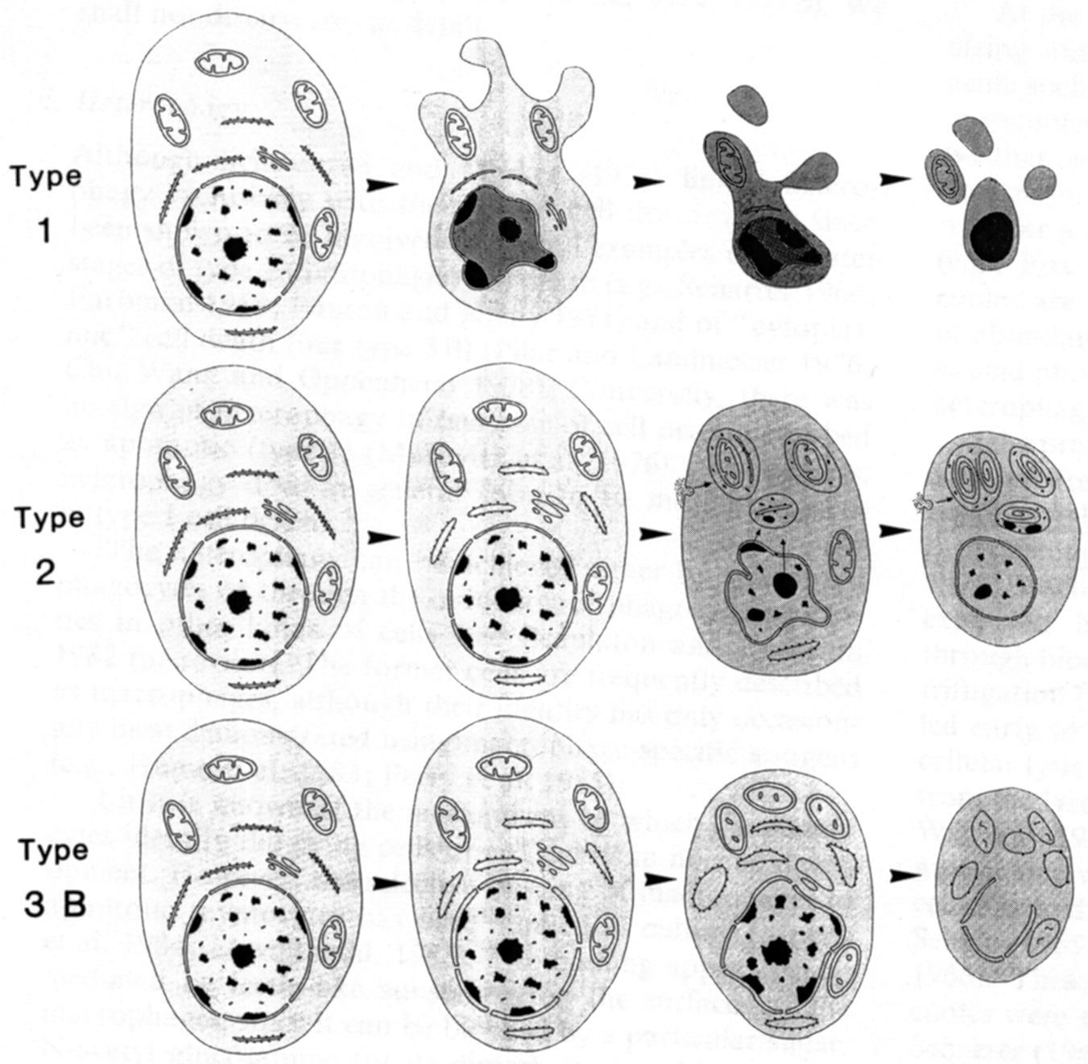
Dokazivanje ultrastrukturalnih obilježja apoptoze
do sada su obilježja apoptoze proučavana uglavnom na limfocitima i neuronima, manje na mišićnim stanicama
kondenzacija jezgre i citoplazme
fragmenacija DNA u oligonukleosomalne fragmente putem aktiviranih endonukleaza
kondenzacija kromatina sve do piknoze jezgre
protruzije stanične membrane (zvjezdolik izgled)
stvaranje “apoptotičkih tijela” i odstranjivanje heterofagocitozom
Clarke P, Anat Embryol, 1990

Slide 8
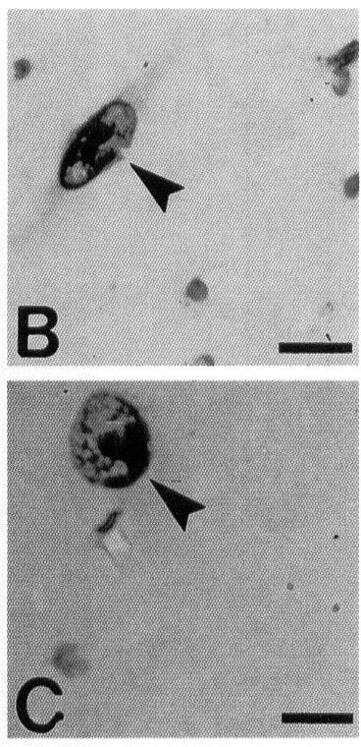
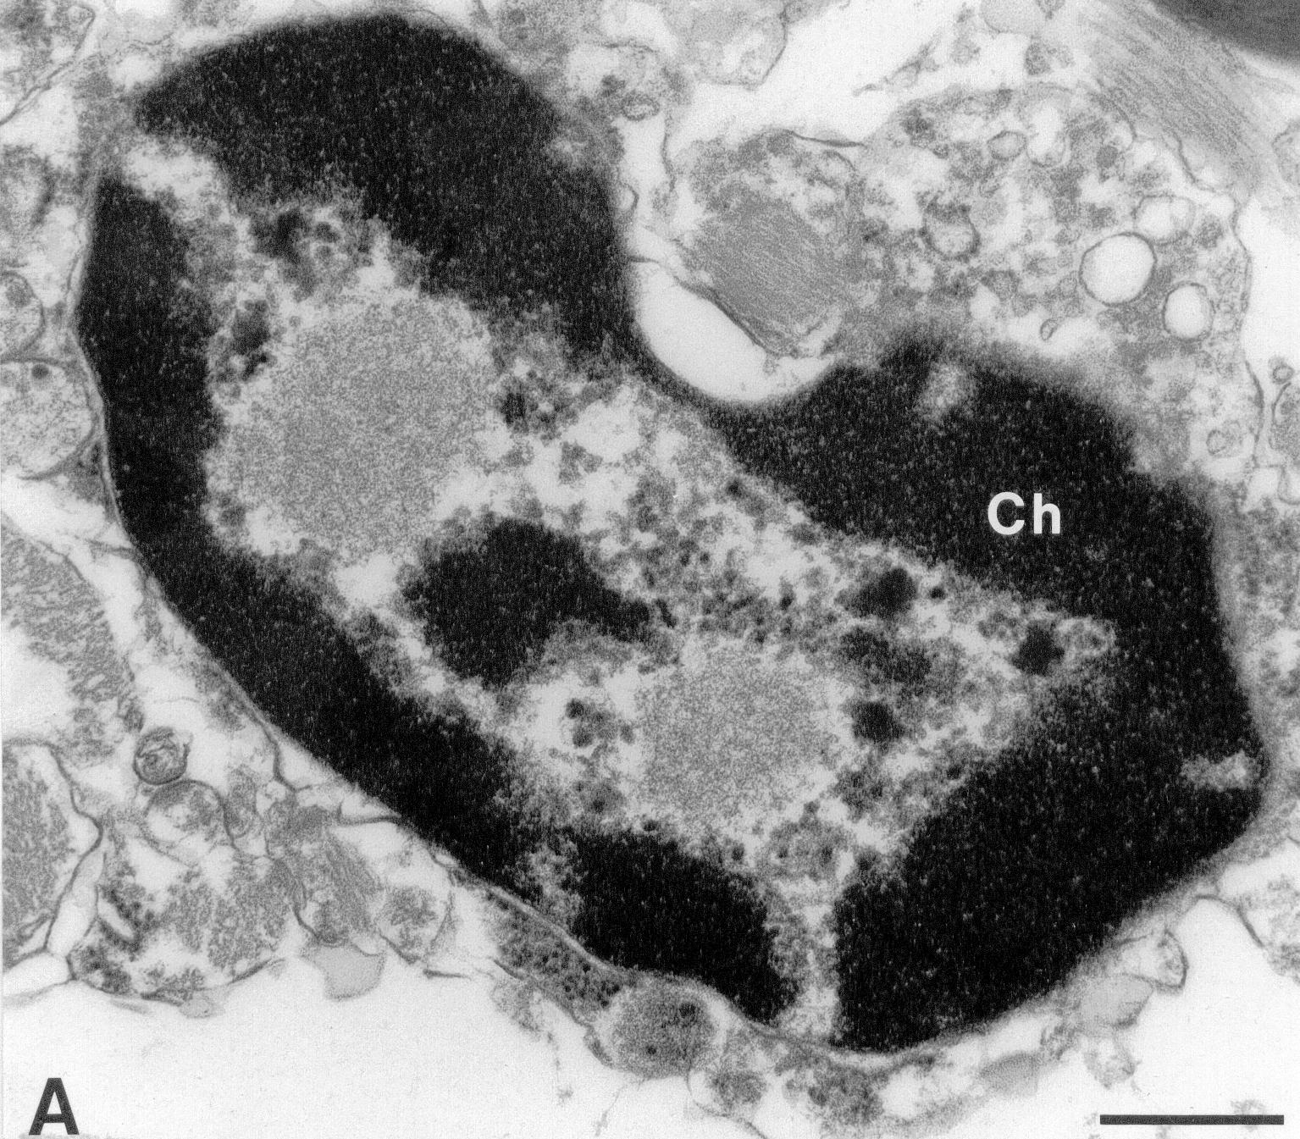
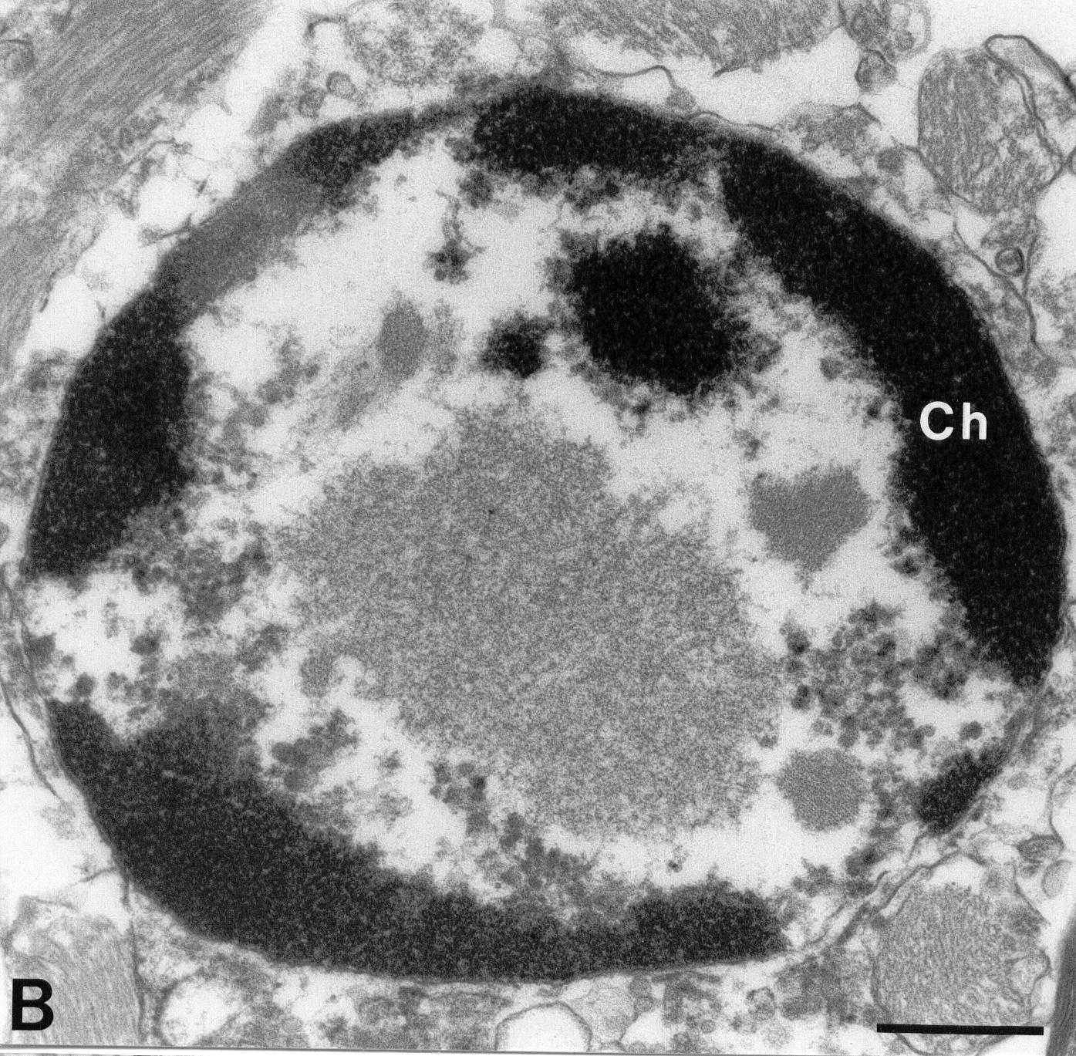
Tip 1 (apoptoza) – rane promjene
TUNEL
Šimić G. et al., J. Neuropathol.
Exp. Neurol. 2000

Slide 9
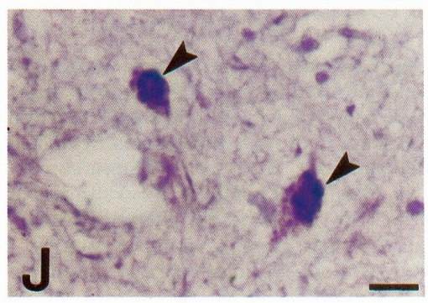
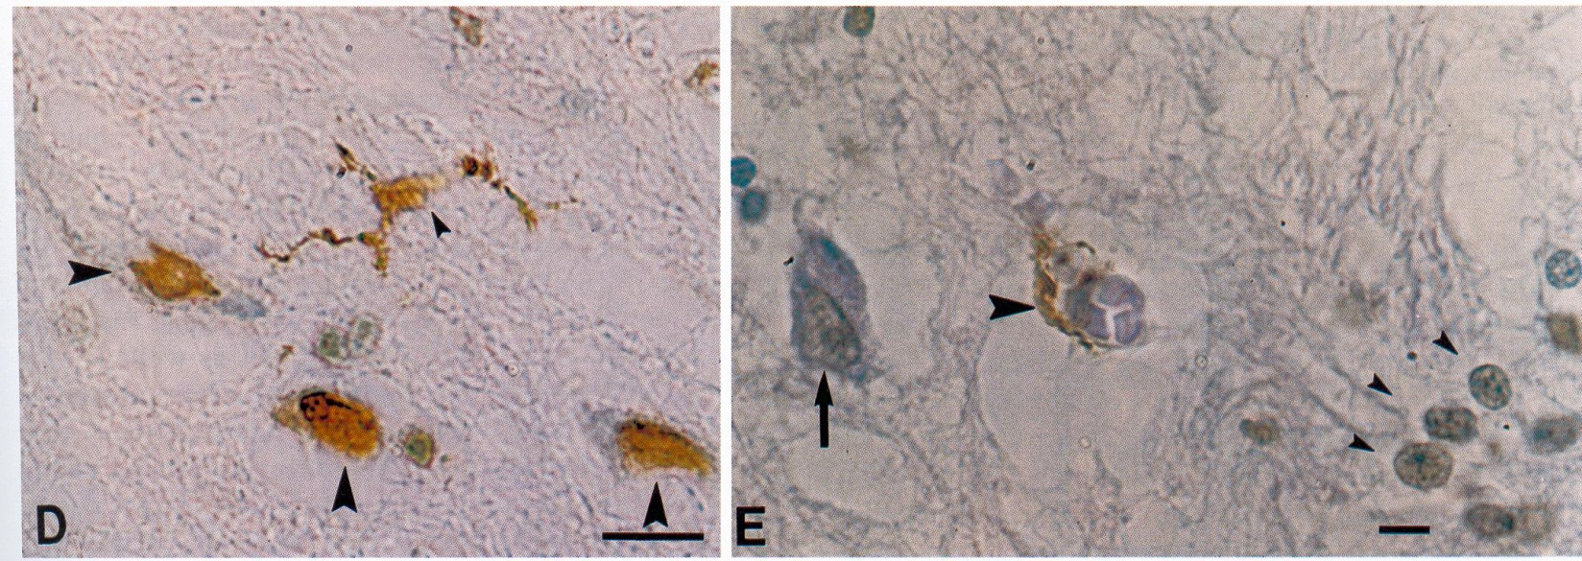
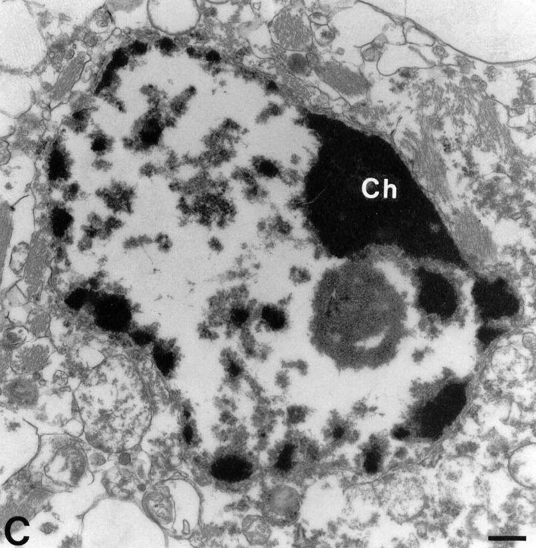
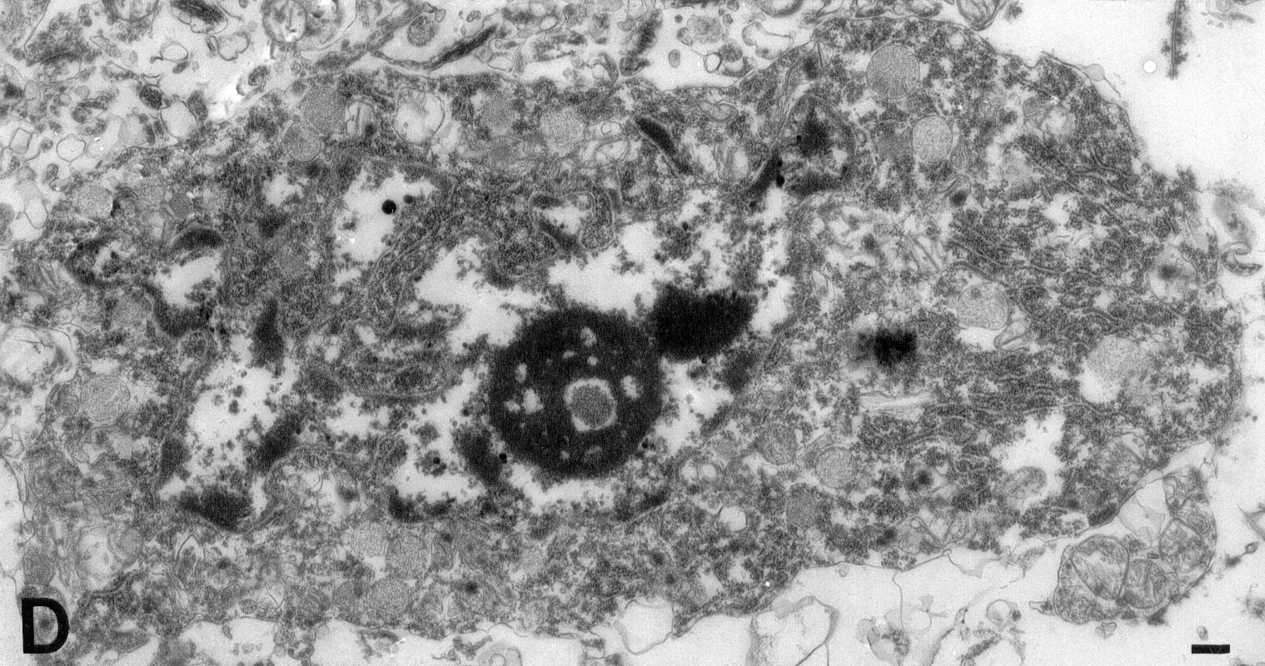
Tip 1 (apoptoza) – kasne promjene
Nissl
ISEL
Šimić et al., J. Neuropathol.
Exp. Neurol. 2000

Slide 10
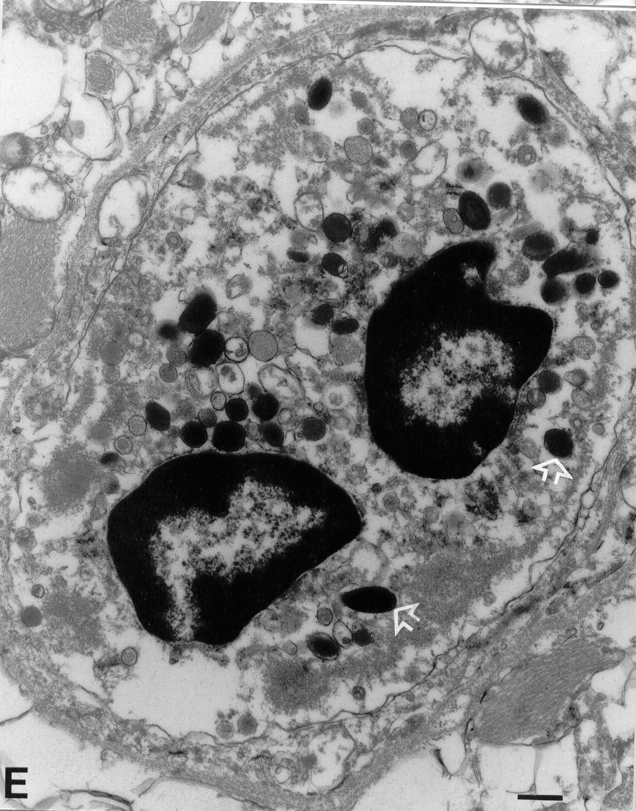
Tip 1 / tip 2 (apoptoza/autofagija)
Šimić et al., J. Neuropathol.
Exp. Neurol. 2000

Slide 11
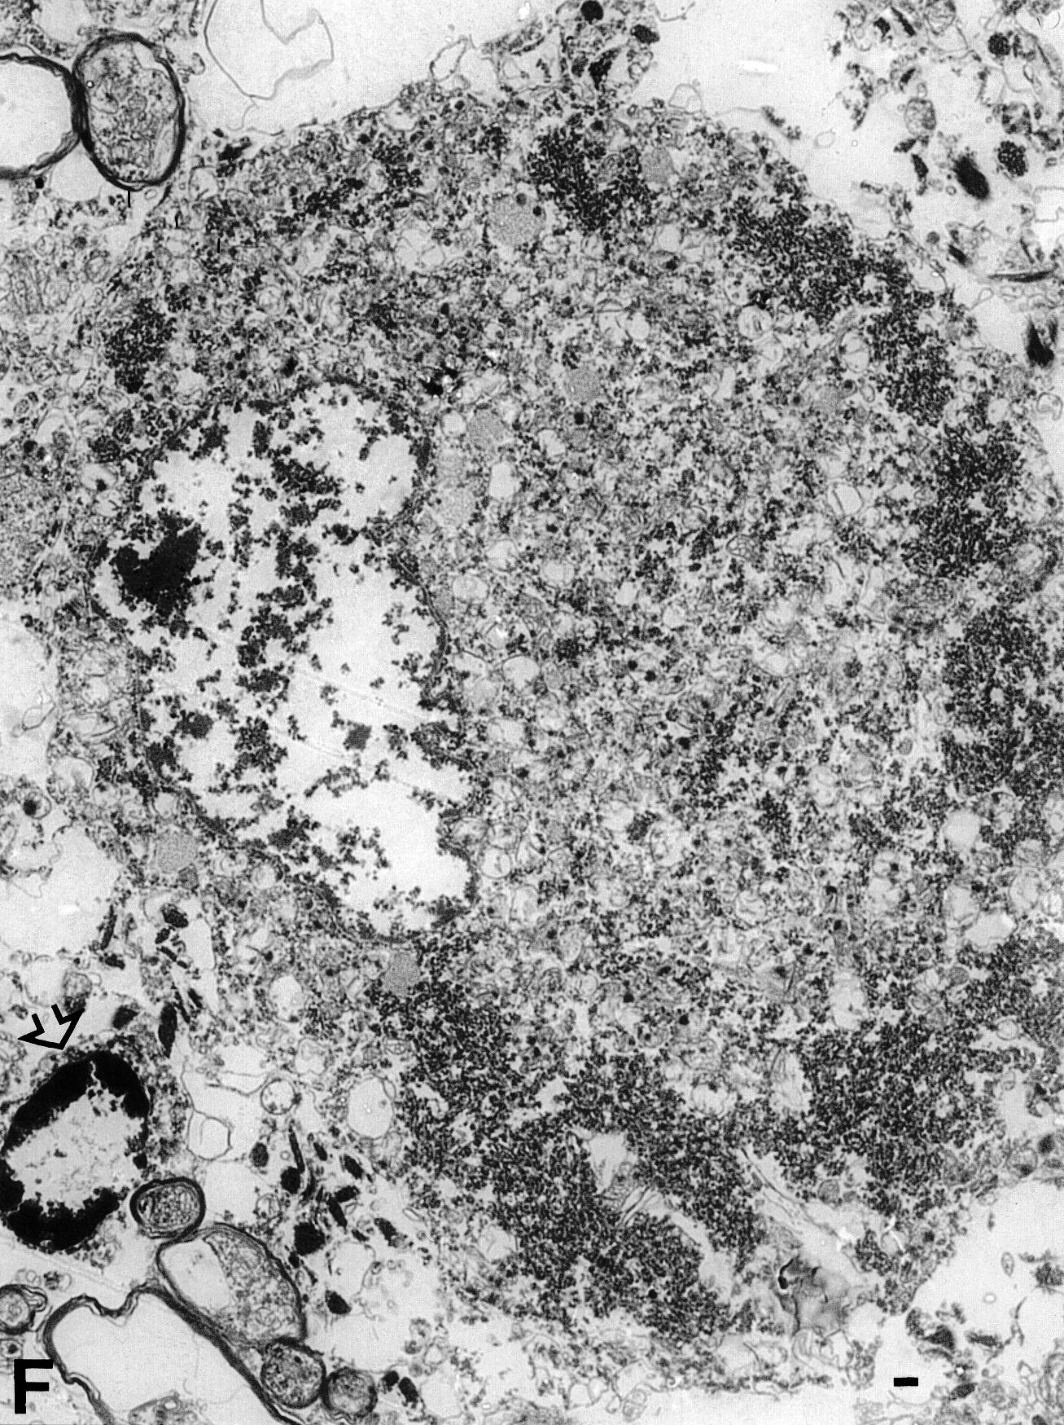
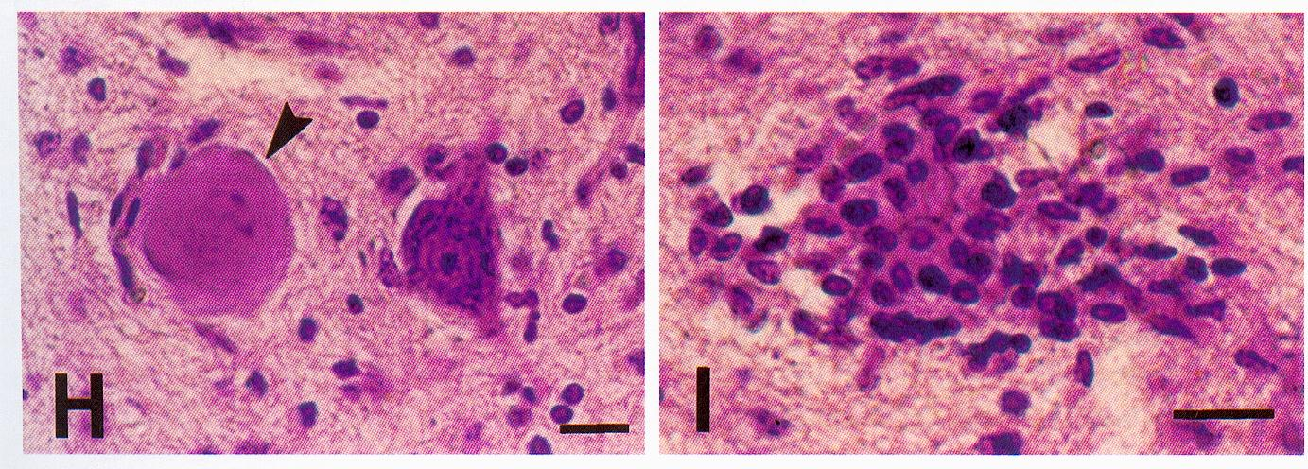
Tip 3b (citoplazmatska smrt, nekroza)
Šimić G et al., J. Neuropathol. Exp. Neurol. 2000;
Šimić G, Acta Neuropathol., 2008

Slide 12
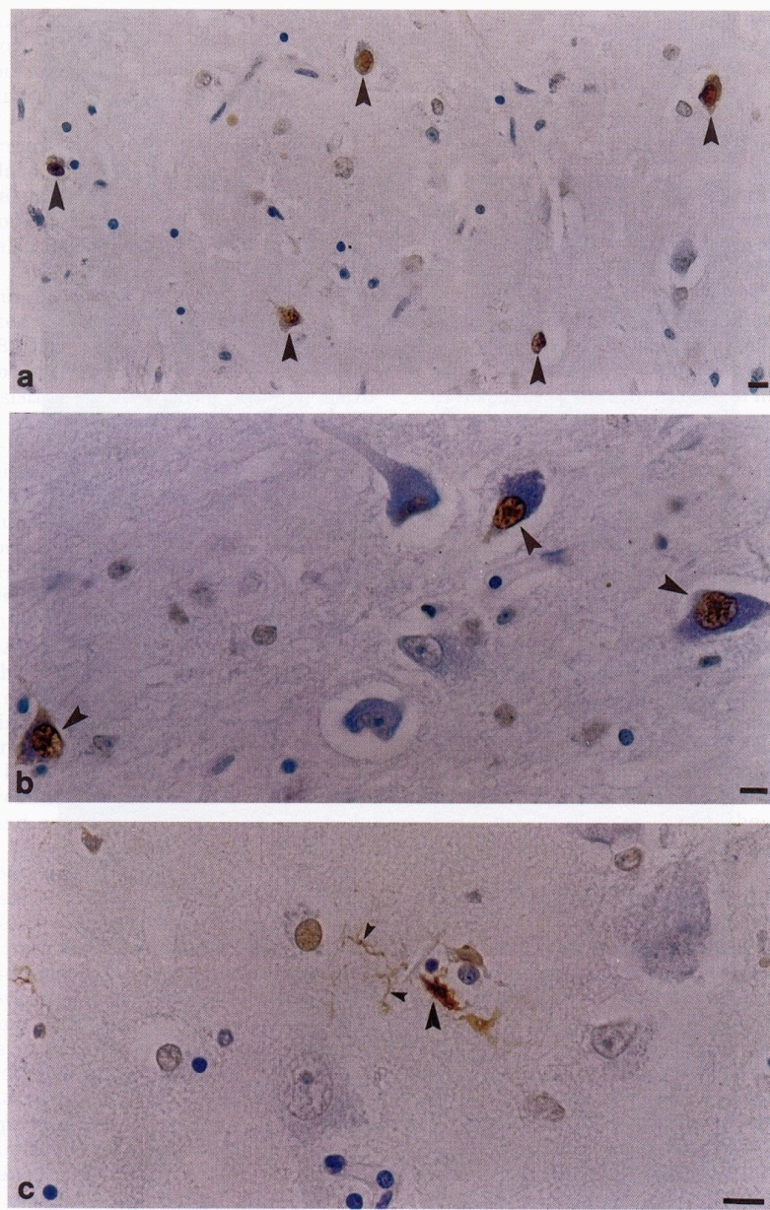
Apoptoza u neurodegenerativnim bolestima
Nema izražene apoptoze živčanih
stanica u Alzheimerovoj
bolesti (Šimić G. et al., Exp.
Neurol. 2000)

Slide 13
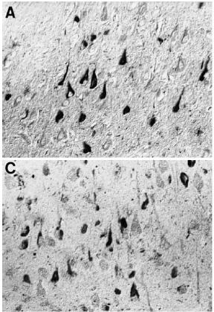
Abortivna apoptoza (abortoza)
Budući da su u AD aktivirane neke aktivacijske kaspaze, npr. kaspaza 8 (slika A) i kaspaza 9 (slika C) u CA1 području hipokampusa (Raina et al., 2001), ali nisu izvršne (npr. kaspaze 7, 6 i 3), ovaj proces je nazvan abortivna apoptoza (abortoza).
Reina et al., 2001

Slide 14
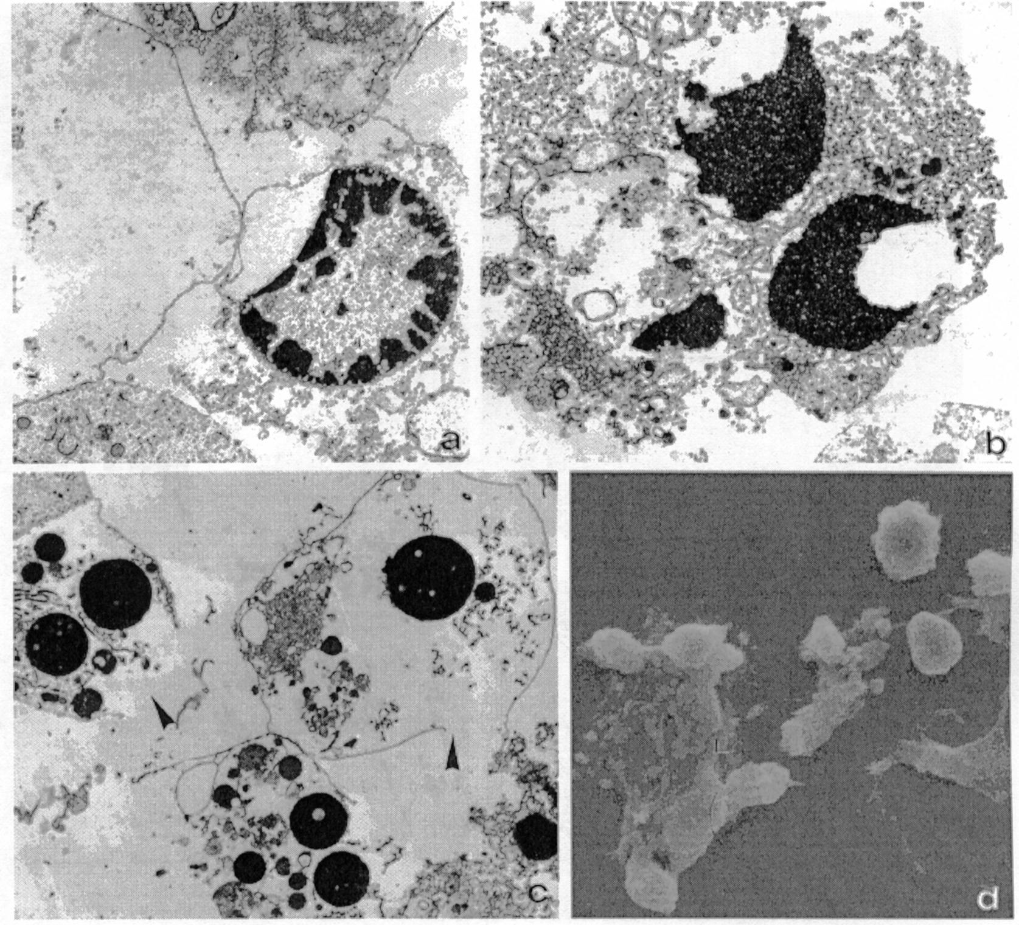
Tip 4 (aponekroza, abortoza)
Cheng et al.,
Biochem. J. 2003

Slide 15
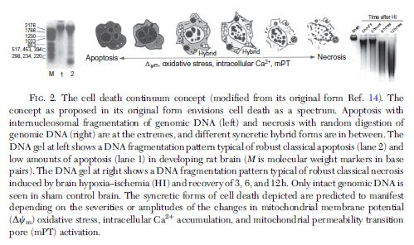
Stanična smrt – kontinuum promjena
Martin, Prog. Mol. Biol. 2012

Slide 16
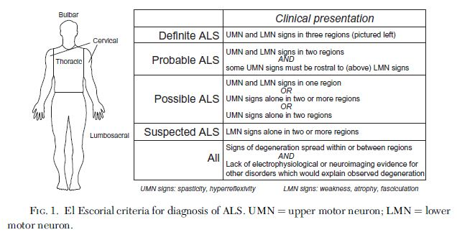
ALS (Lou „Buster” Gehrig’s disease)
Ledler & Dokholyan, Prog. Mol. Biol. 2012

Slide 17
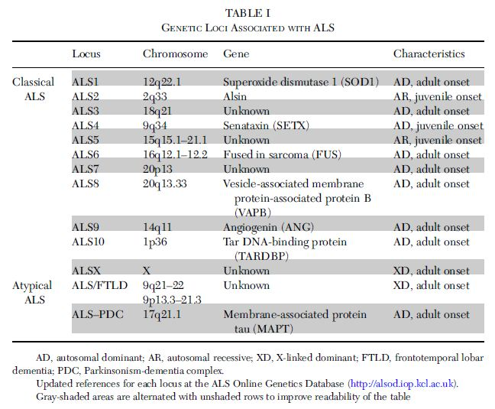
Mutacije gena povezanih s nastankom fALS
Ledler & Dokholyan, Prog. Mol. Biol. 2012

Slide 18
Mutacije Cu,Zn-SOD1 gena
Ledler & Dokholyan, Prog. Mol. Biol. 2012

Slide 19
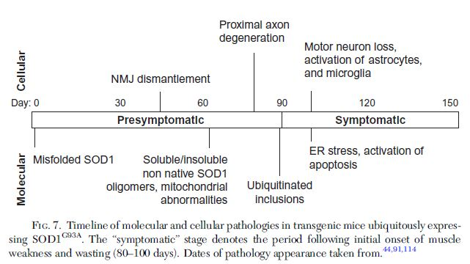
Ledler & Dokholyan, Prog. Mol. Biol. 2012

Slide 20
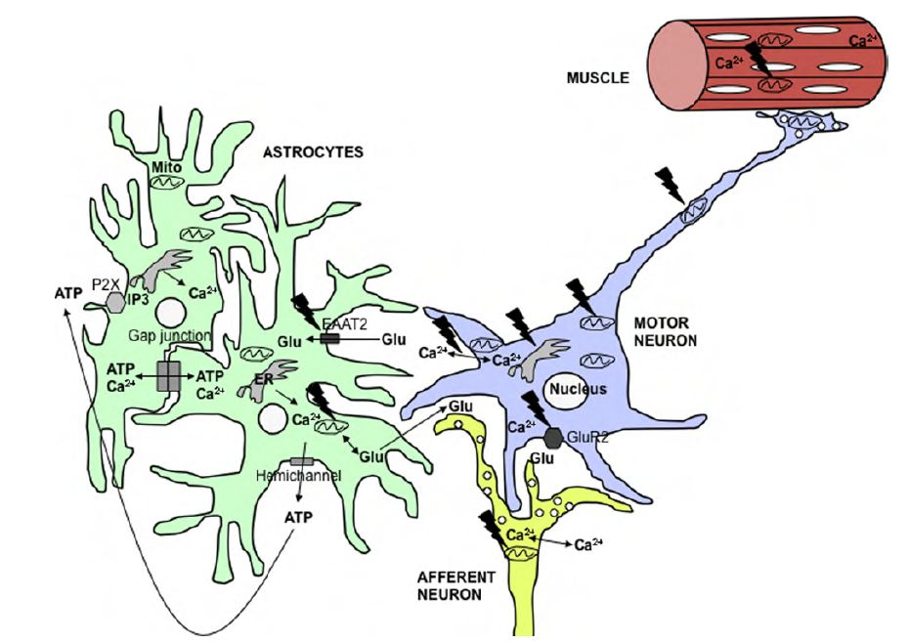
Aktivacija apoptoze u ALS vanjskim putem
Zbog mutacije SOD1, disfunkcionalni protein se veže za VEGF mRNA, zbog čega nastupa gubitak neurotropne potpore aksonima motoneurona (nastupa povlačenje aksona s NMJ).
Ledler & Dokholyan, Prog. Mol. Biol. 2012

Slide 21
Aktivacija apoptoze u ALS unutarnjim putem
Martin, J. Bioenerg. Biomembr. 2011

Slide 22
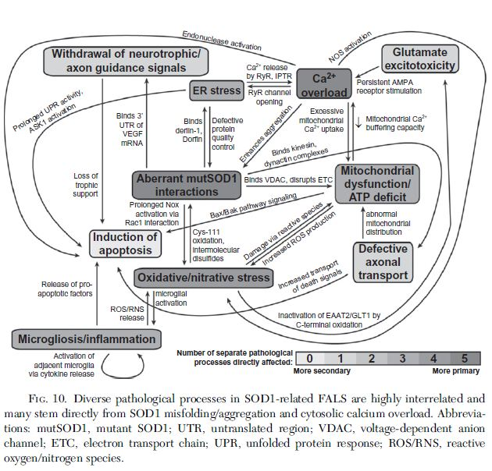
Ledler & Dokholyan, Prog. Mol. Biol. 2012

Slide 23
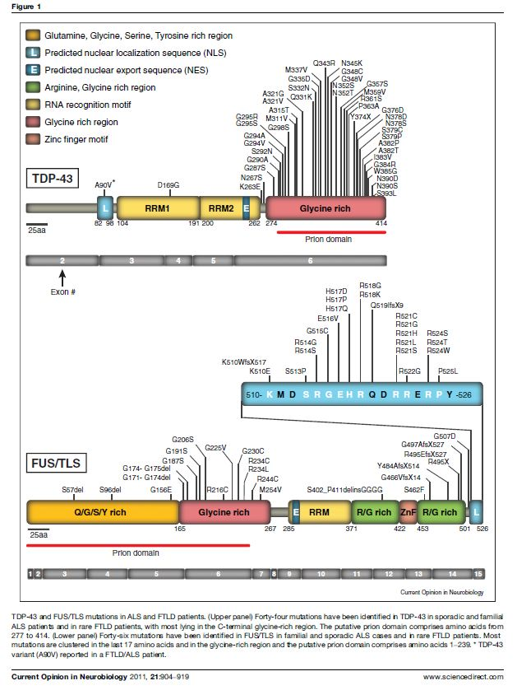
ALS / FTLD-U kontinuum – aktivacija unutarnjeg puta
2006: transactive response DNA
binding protein (TDP-43) i
FUS/TLS (fused in sarcoma or translocated in lyposarcoma)
Arai T et al., TDP-43 is a
component of ubiquitin-positive tau-negative inclusions in FTLD and ALS. Biochem Biophys Res Commun 2006, 351:602-611
Neumann M et al., Ubiquitinated TDP-43 in FTLD and ALS. Science 2006,
314:130-133
Sreedharan J et al., TDP-43
mutations in fALS and sALS, Science 2008, 319:1668-1672
Kwiatkowski TJ Jr et al., Mutations in the FUS/TLS gene on chromosome 16 cause fALS. Science 2009, 323:1205-1208

Slide 24
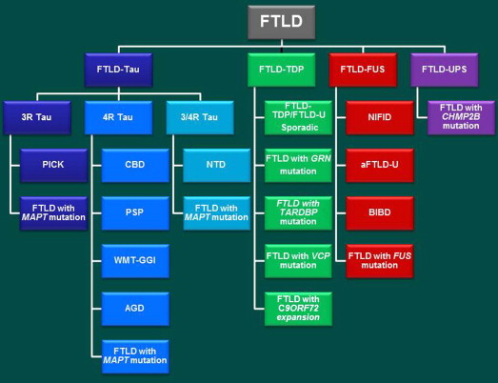
FTLD / ALS – različiti fenotipovi uslijed istih ili sličnih mutacija
Boxer et al., Alzheimer’s & Dementia, 2012

